Slide 1
Database Systems
Lecture 10
Relation Types, Relationship Sets,
Roles and Structural Constraints

Slide 2
Today’s agenda
Relationships
Types, sets and instances
Degree of relationship
Recursive Relationship
Constraints on Relationship Types
Attributes of Relationship Types

Slide 3
Relationships
A relationship relates two or more distinct entities with a specific meaning.
For example, EMPLOYEE John Smith works on the ProductX PROJECT, OR
EMPLOYEE Franklin Wong manages the Research DEPARTMENT.
Relationships of the same type are grouped or typed into a relationship type.
For example, the WORKS_ON relationship type in which EMPLOYEEs and PROJECTs participate, OR
the MANAGES relationship type in which EMPLOYEEs and DEPARTMENTs participate.

Slide 4
Relationship Types, Sets and Instances
A relationship type R among n entity types E₁, E₂, •• , E_{n} defines a set of association or a relationship set__among entities from these entity types.
the relationship set R is a set of relationship instances r_{i}, where each r_{i} associates n individual entities (e₁, e₂,..., e_{n})
Each entity e_{j} in r_{i} is a member of entity type E_{j} , 1 <= j <= n.
A relationship type is a mathematical relation on E₁, E₂, ••• ,E_{n}
Each of the entity types E₁, E₂, ... , E_{n} is said to participate in the relationship type R; similarly, each of the individual entities e₁, e₂, ... , e_{n} is said to participate in the relationship instance r_{i} = (e₁, e₂, ..., e_{n})

Slide 5
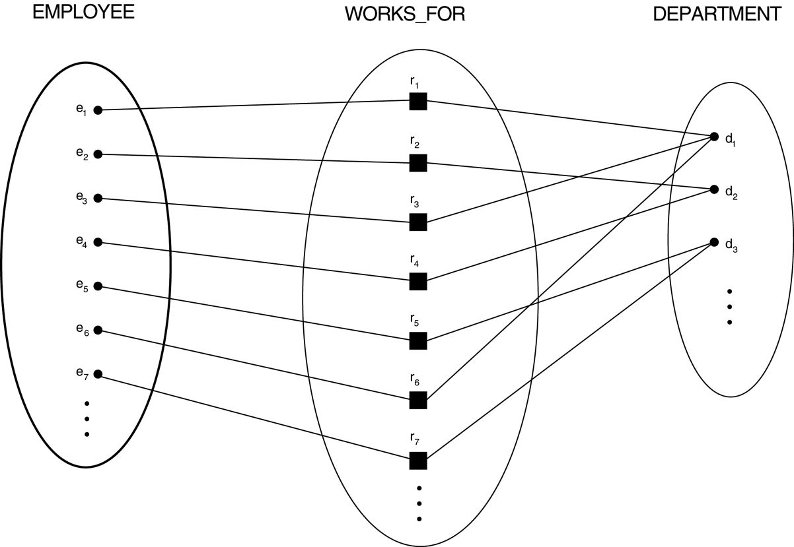
Some instances in the WORKS_FOR relationship set, which represents a relationship type WORKS_FOR between EMPLOYEE and DEPARTMENT

Slide 6
Degree of a Relationship
Is the number of participating entity types
The WORKS_FOR relationship is of degree two.
A relationship type of degree two is called binary
A relationship type of degree three is called ternary

Slide 7
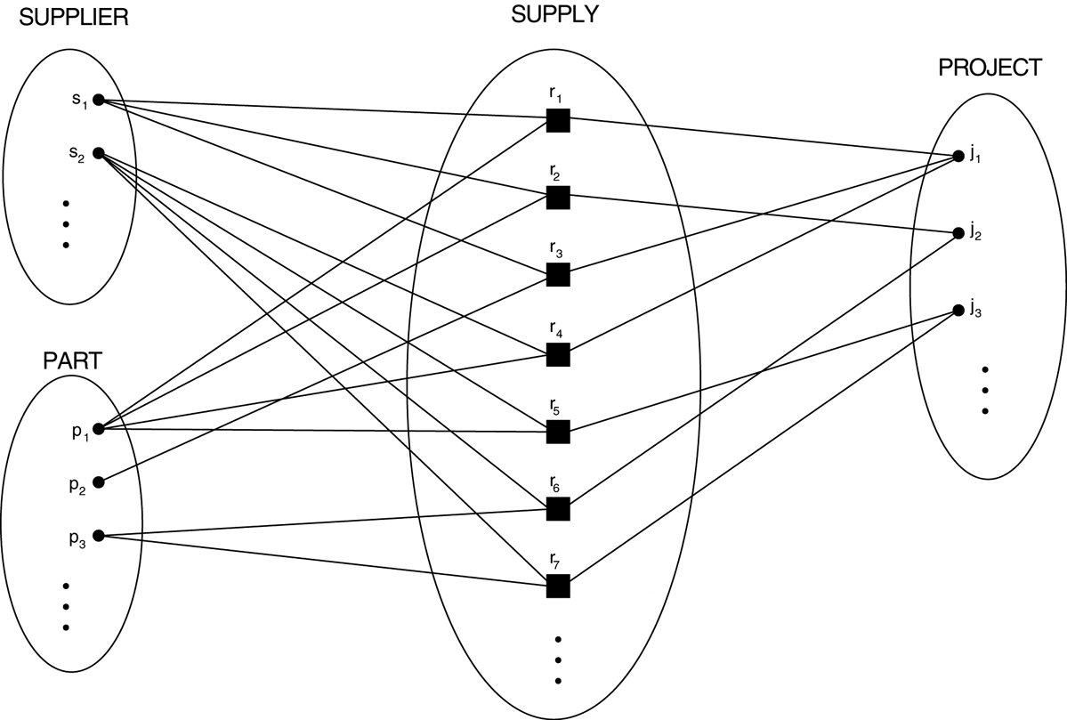
Some relationship instances in the SUPPLY ternary relationship set

Slide 8
Role Name
The role name signifies the role that a participating entity from the entity type plays in each relationship instance, and helps to explain what the relationship means.
For example, in the WORKS_FOR relationship type, EMPLOYEE plays the role of employee or worker and DEPARTMENT plays the role of department or employer.

Slide 9
Recursive Relationship
In some cases the same entity type participates more than once in a relationship type in different roles
Such relationship types are called recursive relationships
The SUPERVISION relationship type relates an employee to a supervisor, where both employee and supervisor entities are members of the same EMPLOYEE entity type.

Slide 10
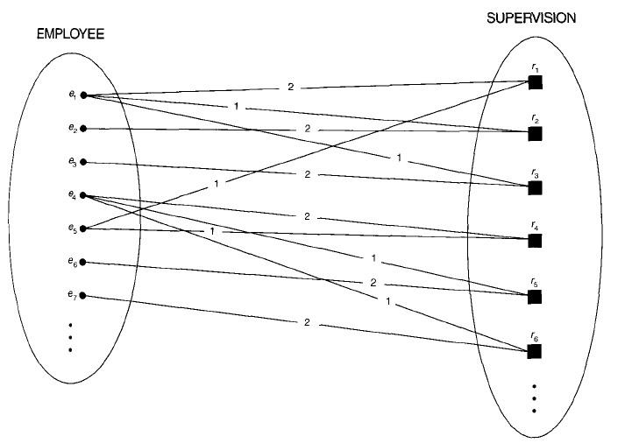
A recursive relationship SUPERVISION between EMPLOYEE in the supervisor role (1) and EMPLOYEE in the subordinate role (2).

Slide 11
Constraints on Relationship Types
Constraints are determined from the mini world situation that the relationships represent.
We can distinguish two main types of relationship constraints:
Cardinality ratio
Participation

Slide 12
Cardinality Ratios for Binary Relationships
The cardinality ratio for a binary relationship specifies the maximum number of relationship instances that an entity can participate in.
For example, in the WORKS_FOR binary relationship type, DEPARTMENT: EMPLOYEE is of cardinality ratio l:N, meaning that each department can be related to (that is, employs) any number of employees but an employee can be related to (work for) only one department.
binary relationship types are 1:1, 1:N, N:1, and M:N

Slide 13
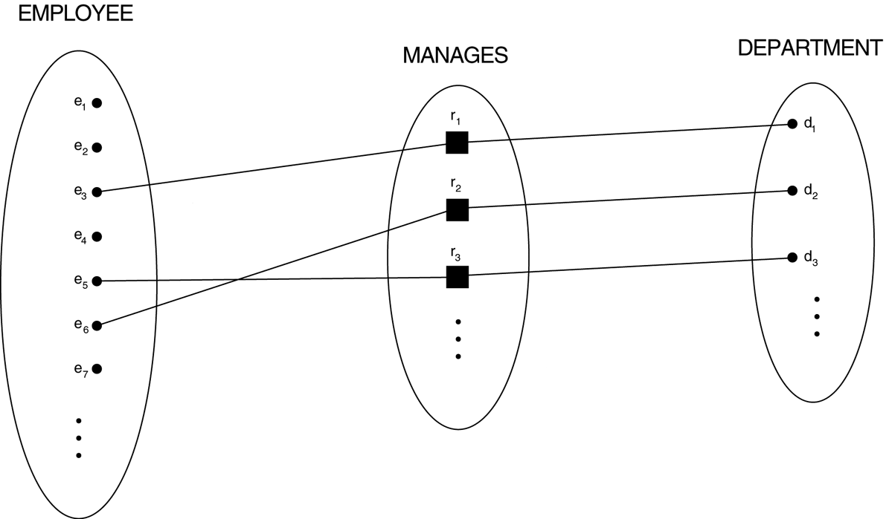
A 1:1 relationship, MANAGES

Slide 14
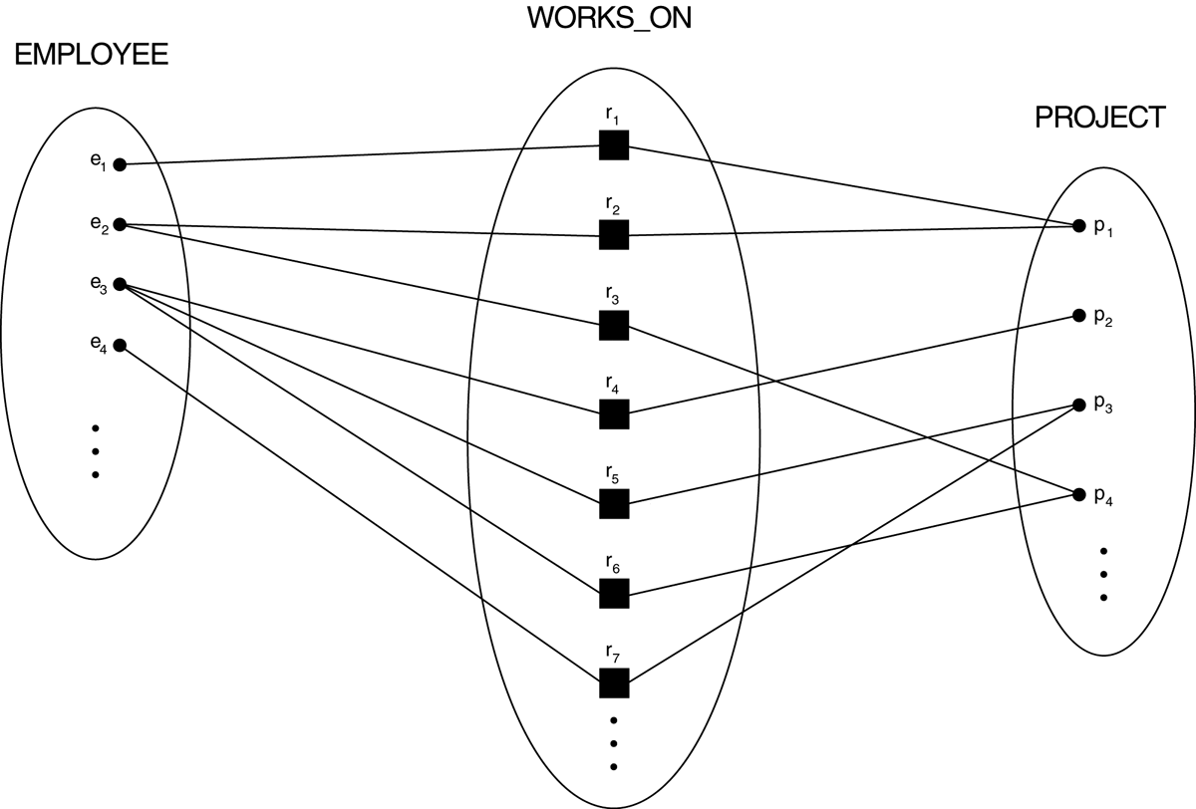
An M:N relationship, WORKS_ON

Slide 15
Participation Constraints and Existence Dependencies
The participation constraint specifies whether the existence of an entity depends on its being related to another entity via the relationship type
This constraint specifies the minimum number of relationship instances that each entity can participate in,
Sometimes called the minimum cardinality constraint
There are two types of participation constraints, i.e., total and partial

Slide 16
Total and Partial Constraints
If a company policy states that every employee must work for a department, then an employee entity can exist only if it participates in at least one WORKS_FOR relationship instance
Meaning that every entity in "the total set" of employee entities must be related to a department entity via WORKS_FOR
Also called existence dependency
The participation of EMPLOYEE in the MANAGES relationship type is partial
Meaning that some or "part of the set of" employee entities are related to some department entity via MANAGES

Slide 17
Attributes of Relationship Types
Relationship types can also have attributes, similar to those of entity types.
For example, to record the number-of-hours per week that an employee works on a particular project
Notice that attributes of 1:1 or 1:N relationship types can be migrated to one of the participating entity types
For M:N relationship types, some attributes may be determined by the combination of participating entities in a relationship instance, not by any single entity.

Slide 18
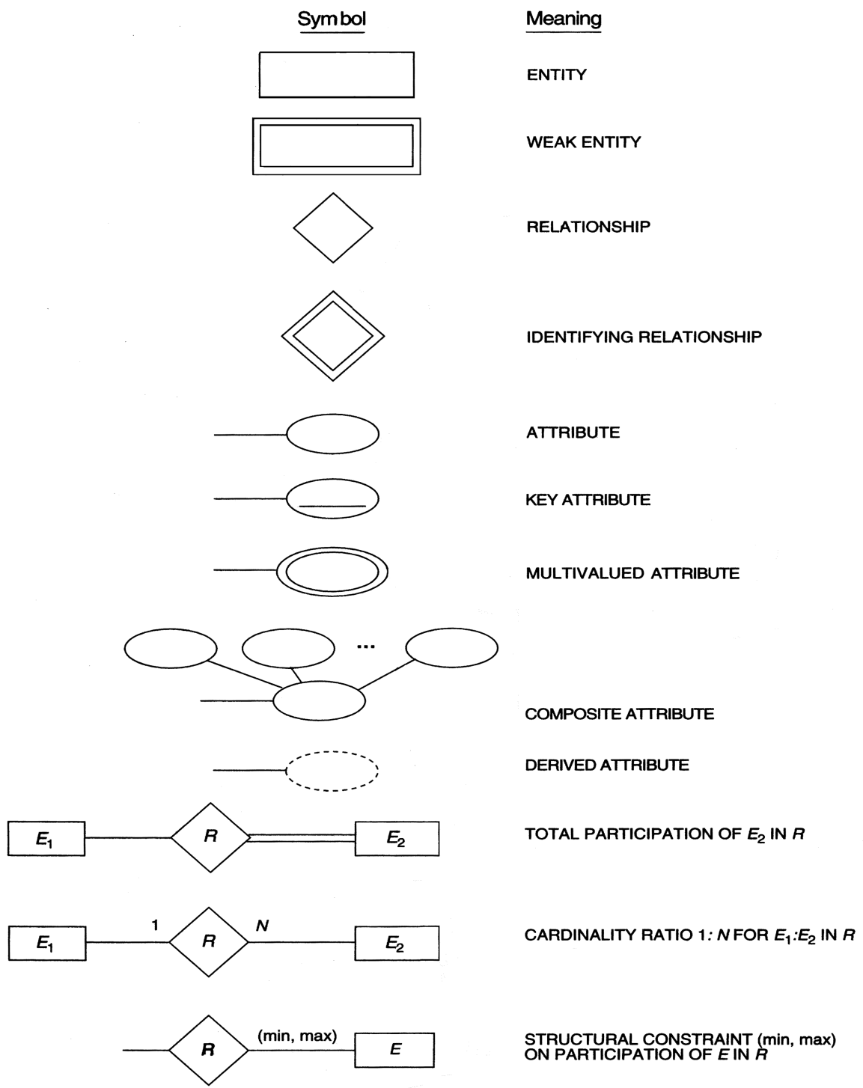
SUMMARY OF ER-DIAGRAM NOTATION FOR ER SCHEMAS

